Slide 1


Wavelength-Variable Three-Dimensional Rainbow Camera for Non-invasive Ophthalmic Measurements
Fabian Wildenstein
2016 Arizona State-Wide Space Grant Symposium
Mentor: Dr. Jim Schwiegerling (Professor, Optical Sciences)
April 16, 2016

Slide 2

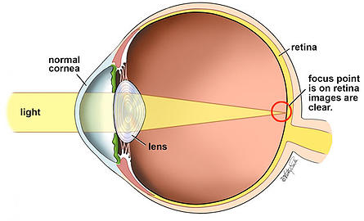
Refractive Surgery History
Refractive eye surgeries relatively new
Surface shape of eye determines optical properties
Purpose: reshape refractive elements in the eye to correct sight problems
Procedures typically permanent
BoydVision (2016)
Notes:
http://www.boydvision.ca/how-custom-lasik-works/

Slide 3
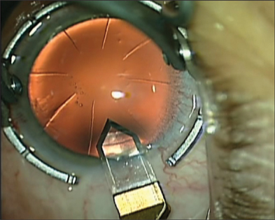
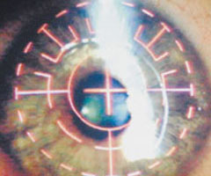
Surgical Techniques
Incision Procedures
  Controlled incisions to alter the shape of the cornea
Surface/Flap Procedures
  Surface: Excimer laser used to ablate outer layer of cornea, epithelium, and connective tissue
  Flap: Thin flap of corneal tissue folded back, excimer laser used to precisely ablate and reshape the interior cornea. Flap is then replaced
Devgan, U. (2009)
Consumer Reports (2013)
Notes:
http://www.ophthalmologymanagement.com/articleviewer.aspx?articleID=102450
http://www.consumerreports.org/cro/2013/02/lasik-eye-surgery/index.htm

Slide 4
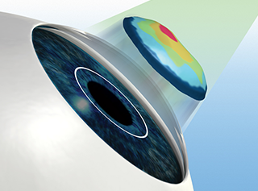
Problems With Laser Surgery
Must know current eye shape
  Precise eye measurements needed before surgery
Based on personalized eye maps, the laser is programmed to reshape the cornea in a specific way to obtain the desired curvature
All About Vision (2016)
Notes:
http://www.allaboutvision.com/ilasik/

Slide 5
Project Objective
Create system to quickly and accurately map the outer surface of the eye
  System must create three-dimensional model using two-dimensional image
  Model must have the capability to reproduce the geometry of reflective structures of eye (i.e. the sclera)

Slide 6
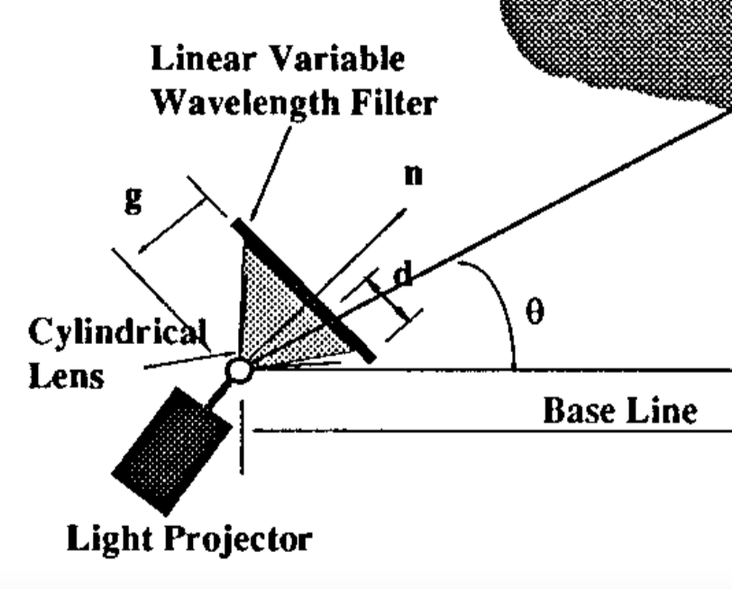
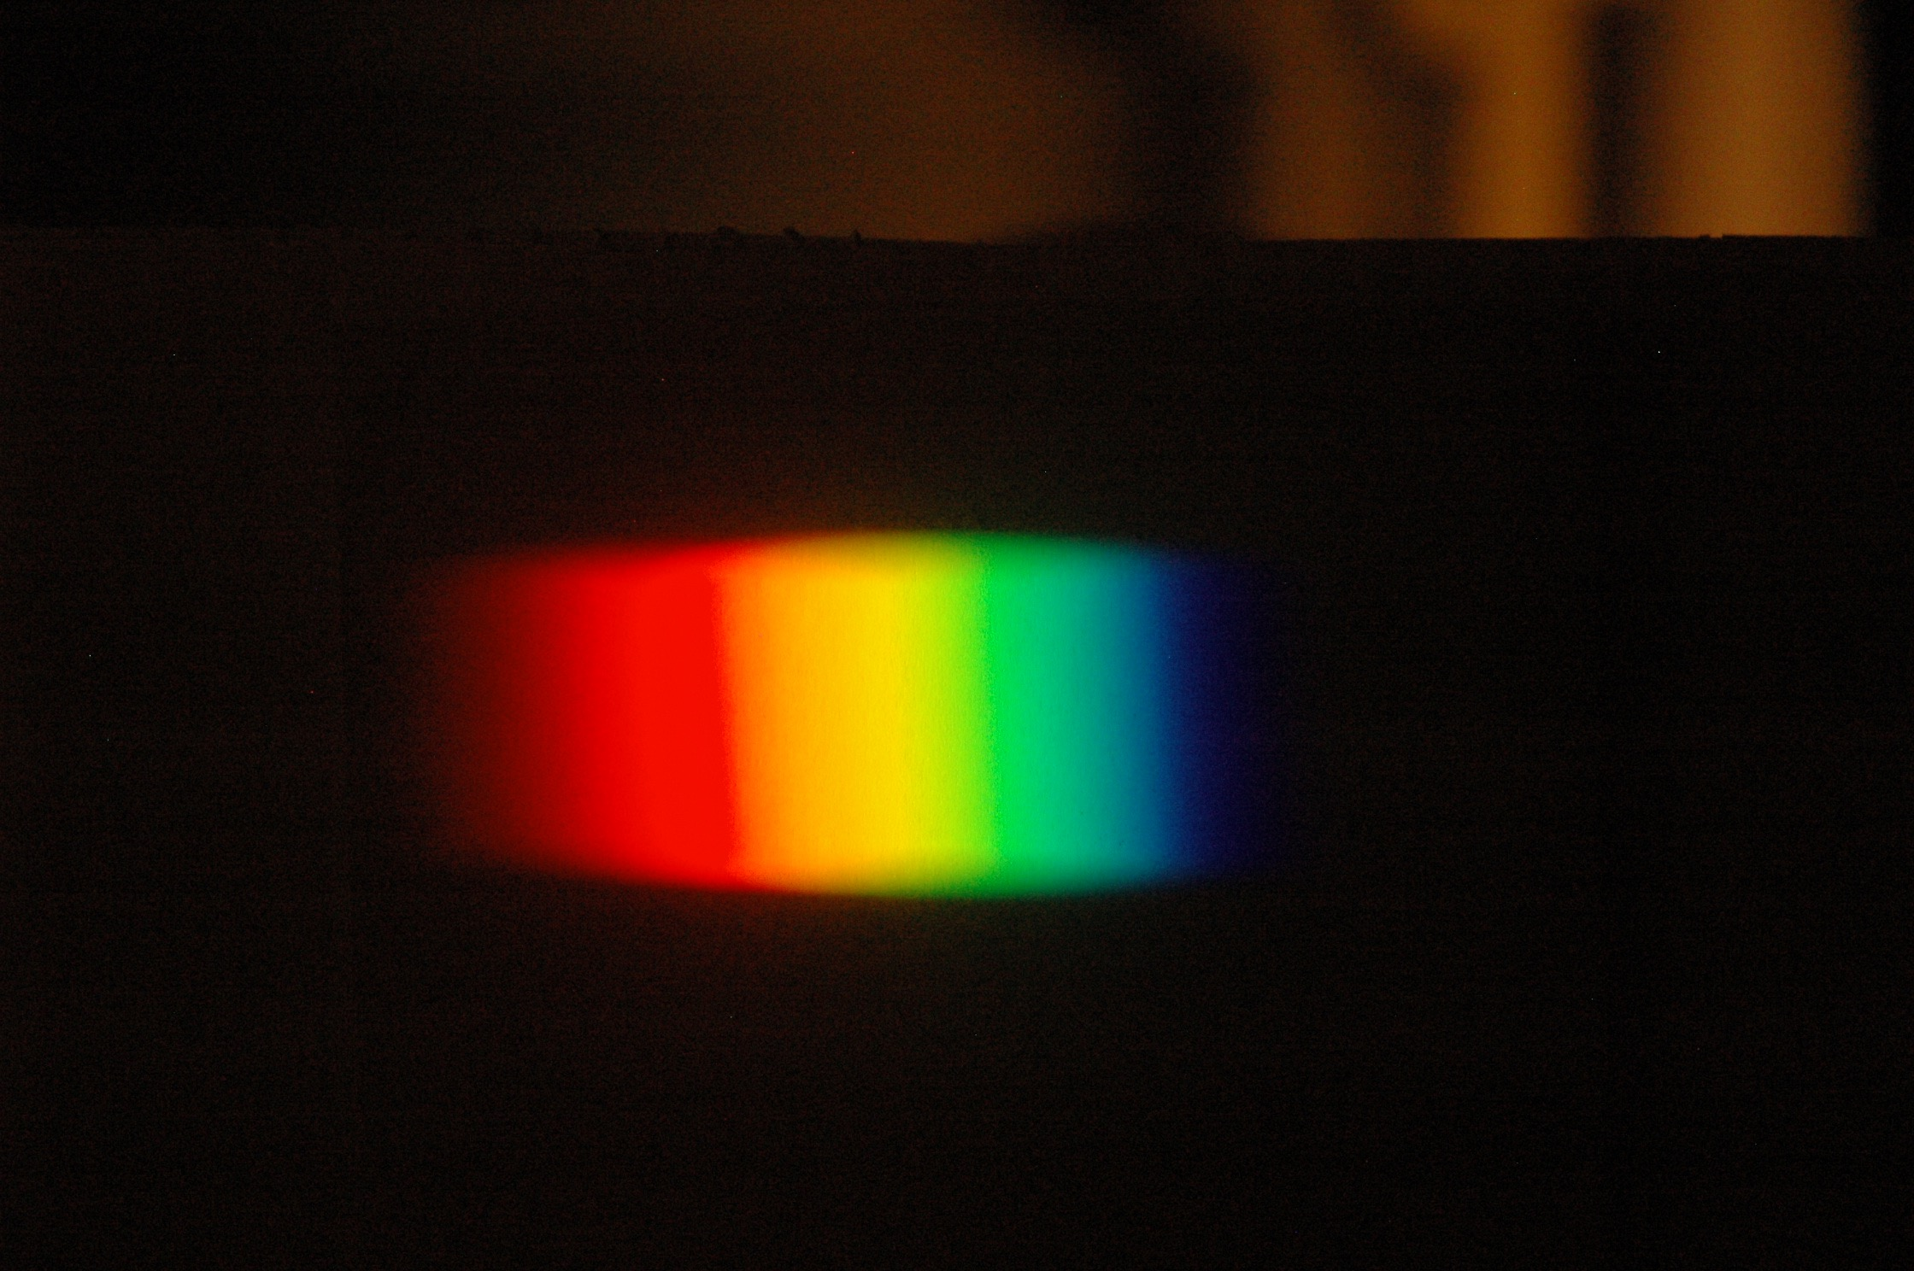
Rainbow Camera Mapping
Technique
Rainbow fan pattern projected onto object using white light source and linear variable wavelength filter
Geng (1996)

Slide 7
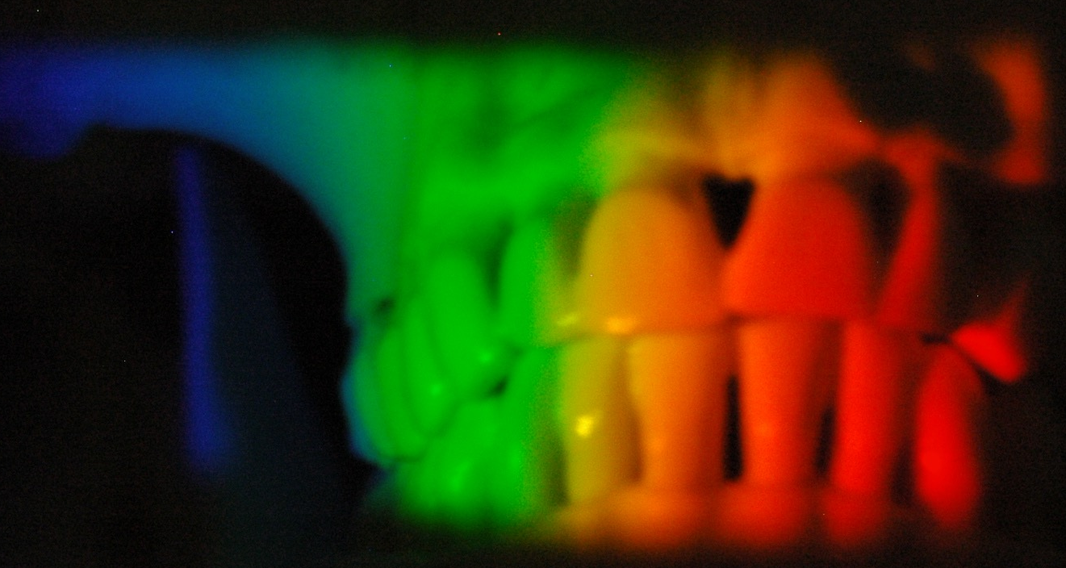
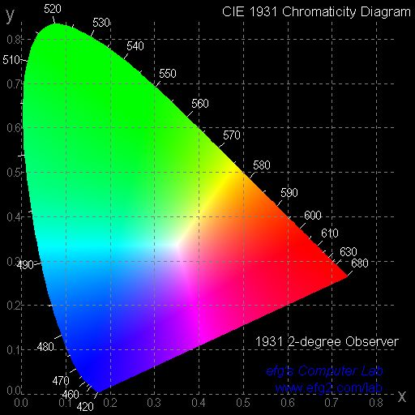
Rainbow Camera Mapping
Technique
Take picture of rainbow pattern
RGB values extracted from each pixel, converted into tristimulus and then chromaticity information
Chromaticity information used to extract wavelength information from each pixel
Notes:
http://www.efg2.com/Lab/Graphics/Colors/Chromaticity.htm

Slide 8
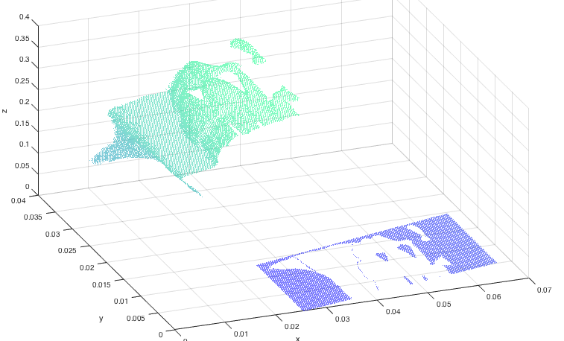
Rainbow Camera Mapping
Technique
Use geometric profiling algorithm based on system setup to create position rendering of object from reflected wavelengths

Slide 9
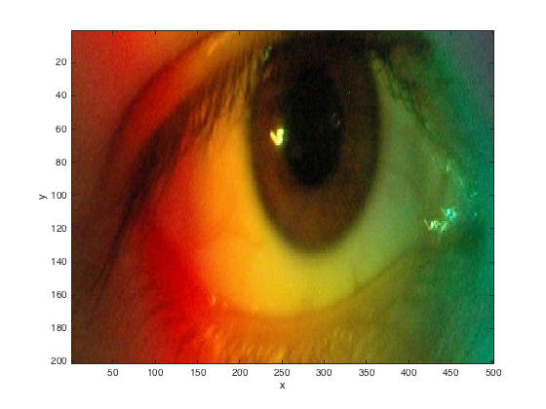
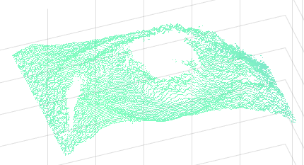
Results:
3D Eye Renderings

Slide 10
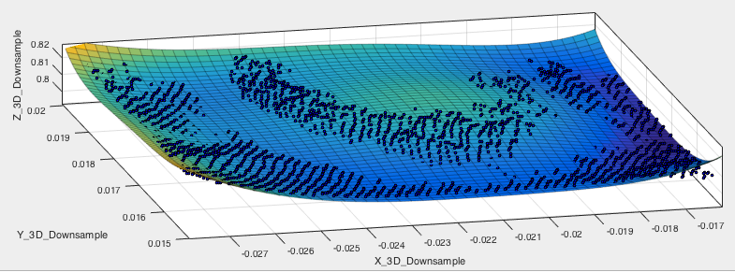
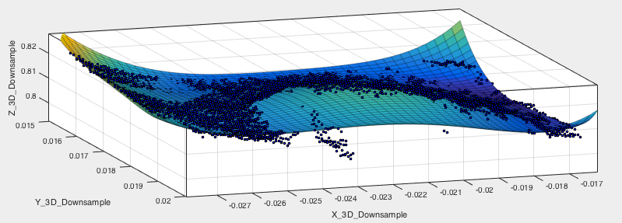
3D Geometric Mapping

Slide 11
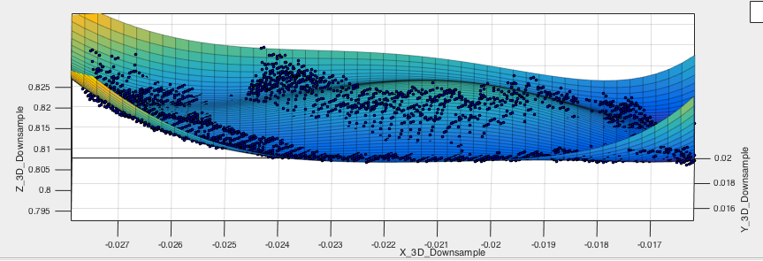
Detection of Abnormalities
Future: Develop masks and model eye using Zernike polynomials or other technique

Slide 12
Interpretations of Results and
Significance
Validates fast, inexpensive, and efficient technique for mapping eye/corneal surface
Geometric rendering is good, but quality could be improved through use of better modeling polynomials
Potential for real time/video analysis
With refinement, technique could become valuable ophthalmological tool

Slide 13
Acknowledgements
Dr. Jim Schwiegerling
Eddie LaVilla
NASA Space Grant Consortium
College of Optical Sciences

Slide 14
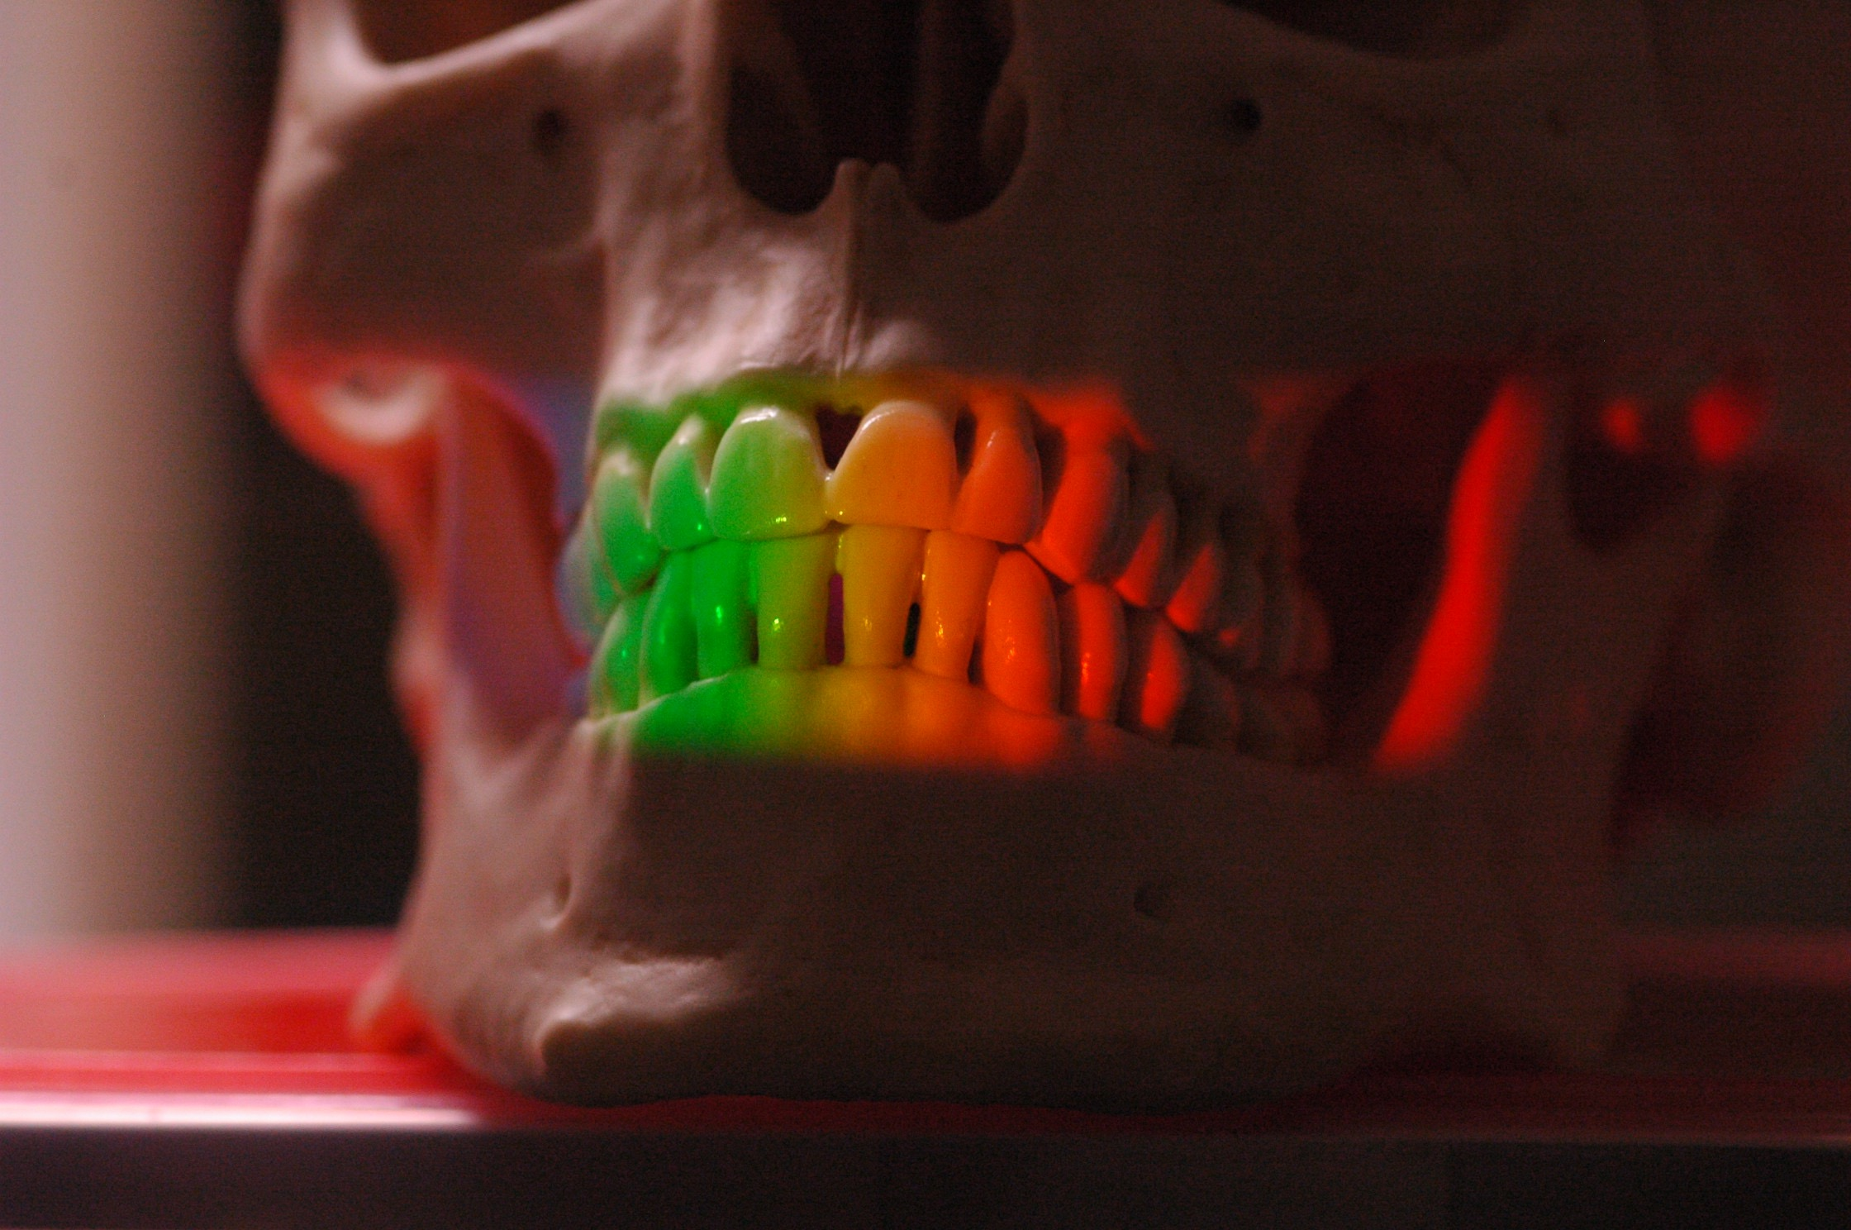
Thank You

